Slide 1
So, you’re thinking about an upgrade to Project 25…
This is a lot to think about…

Slide 2
Three Main Considerations:
Internal Culture – the specific organizational and operational needs of the end-users and maintainers
Procurement, Funding and Sustainment – through federal grant programs for acquisition of Project 25 systems and subscribers
Technology – with it’s many variations that can be customized to the needs of the end-users and maintainers, and to the satisfaction of key stakeholders

Slide 3
Internal Cultural Issues
Your internal organizations and user’s groups have particular needs which must be addressed:
How does the transition from analog to digital affect them?
How do we organize your users’ groups to maximize efficiencies?
How do we maintain or broker required ‘Interoperability’ with other agencies in adjacent cities/counties or States?
How do we resolve the ‘understanding gap’?

Slide 4
Internal Cultural Issues: The Solution
Education and Training
A must when introducing any new technology; and it’s a big part of our commitment to you
Fleet Mapping
If you aren’t already ‘trunked’, this process can be daunting
Coalition Building for Interoperability
We stand with all our customers
Understanding
It’s important that we understand your problems.
It’s equally important that you understand our solutions!

Slide 5
Procurement, Funding and Sustainment
SAFECOM – administers the federal grant program to provide funding and sustainment money for Project 25 equipment
Office of Emergency Communications – grant guidance for what can and can’t be bought w/SAFECOM funds
FPIC – coordination and advisory body to address technical and wireless operational issues relative to interoperability
Your own Program Management Office in charge of procurement – how that federal money is spent - can be of enormous value in organizing and measuring the efforts of vendors, consultants and your own stakeholders

Slide 6
Technology
Coverage – signal strength which fades with distance from a transmit site
Network Architecture: Simulcast, Multicast or ‘Hybrid’
Trunked or Conventional Repeat
Grade of Service – Erlang C
Frequencies, Bandwidth and Standards
Delivered Audio Quality and Bit Error Rate
Notes:
Coverage: Single-site or multiple sites? This is something the modeling process can reveal.
Architecture: Decision should be based on your capacity needs which may vary from place to place over a large area (e.g. urban vs. rural areas) and your number of channels.
Trunked or Conventional: Also dependent on the number of channels at your disposal
Grade of Service: Based on the percentage of time a trunked system is ‘unavailable’ or busy, and on a specified ‘holding time’

Slide 7
Coverage
Modeled in software – “It’s just a simulation!!”
Measured in the field with test equipment
Both can be ‘overlaid’ in Google Earth – KNOW AND UNDERSTAND THE DIFFERENCE!
Modeling is often a very good representation of actual system performance - BUT IT’S ONLY A MODEL!
KNOW THE DIFFERENCE between modeled performance and actual, measured performance!

Slide 8
Coverage

Slide 9
A Note About Coverage:
Prior slide was ‘talk out’ from a 100 watt repeater
Most P25 systems will be ‘uplink limited’ – the ‘talk in’ ‘footprint’ will be smaller
Static Sensitivity vs. Faded Sensitivity
Just because your portable’s static sensitivity measurement at 5% BER is better than the ‘green’ (-80 dBm) area, it’s not a guarantee that you’ll be able to affiliate with that station in a P25 system – faded sensitivity can be much worse!

Slide 10
Simulcast, Multicast or ‘Hybrid’
Simulcast
Multicast
In a multi-site system, one channel at each of the sites transmits the same signal on the same frequency.
Frequency efficient
Requires identical number of repeaters at each site
Requires ‘voting’ technology
In a multi-site system, one channel at each of the sites transmits the same signal on a different frequency.
Frequency consuming
Allows for a different number of repeaters at each site
Trunked multicast does not require ‘voting’ (i.e. different channels – no overlap of same signal)

Slide 11
Simulcast, Multicast or ‘Hybrid’
For most Public Safety applications, Simulcast is the preferred architecture
Pro: ease of use and more spectrally efficient
Con: higher initial cost and total cost of ownership
Multicast applications can be cost-effective in low-density areas
Hybridized systems can be designed to include elements of both

Slide 12
Trunked or Conventional Repeat
Choice here should be based on the number of users of the system, against the number of available channels
Project 25 systems can be configured either way
Properly configured, a P25 conventional system can offer many of the same managed services as a trunked version; at significant savings to the buyer
“Trunking is a way for a large number of users to share a small number of channels”
“If you have enough channels, you don’t need trunking!”

Slide 13
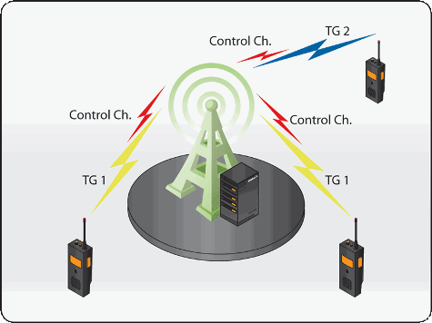
Trunked or Conventional Repeat
Single-site trunked system
Single-site conventional repeater system

Slide 14
Trunked vs. Conventional P25
Trunked
Conventional
More complex and less available
Greater initial expense and total cost of ownership
Added growth depends on the acquisition of more channels or migration to Project 25/Phase 2
Less complex, always available
Less expensive and more easily maintained
Can later be upgraded to trunking

Slide 15
Grade of Service (trunked systems)
For most Public Safety applications, a 5% G.O.S. is acceptable.
5% G.O.S. means the user will experience a busy signal when he keys his/her radio, 5% of the time.
95% of the time, that same user will obtain a channel grant/talk permit tone and can begin speaking to the talk-group.
At this G.O.S. a 5-channel system can support approximately 300 users, depending on ‘hold time’ and other factors.
In P25 systems, one channel at each trunked site is a dedicated ‘control channel’ that receives and sends channel requests and assignments
Too many talk groups programmed into the system tend to erode this service and make it less available to all users!

Slide 16
Grade of Service (trunked systems)

Slide 17
Frequencies, Bandwidth and Standards
Project 25 Phase 1 operates on 12.5 kHz channels
800 MHz channels were planned this way from the beginning
VHF High Band and UHF channels have since been similarly ‘narrow-banded’
700 MHz – except for those portions of the band designated for broadband – are now being developed as Project 25 ‘Phase 2’
Phase 2 Systems operate a 2-slot TDMA on 12.5 kHz channels for spectral efficiency, with backward compatibility to Phase 1-only subscriber technology

Slide 18
Frequencies, Bandwidth and Standards
The Project 25 Suite of Standards is still evolving:
The Common Air Interface (1993) which includes:
The method of trunking (a ‘slotted aloha’ technique)
Narrow-banding from the original 25 kHz channel plan to 12.5 kHz
The current vocoder (voice encoder) – IMBE (Improved Multi-Band Excitation)
Phase 2 systems will use the AMBE (Advanced Multi-Band Excitation) vocoder
The Inter-RF Sub-System Interface
Allows different manufacturer’s systems to be directly interconnected at the controller level
The Console Sub-System Interface
Allows dispatch consoles from different manufacturer’s to be interconnected to the core/controller of other manufacturer’s systems

Slide 19
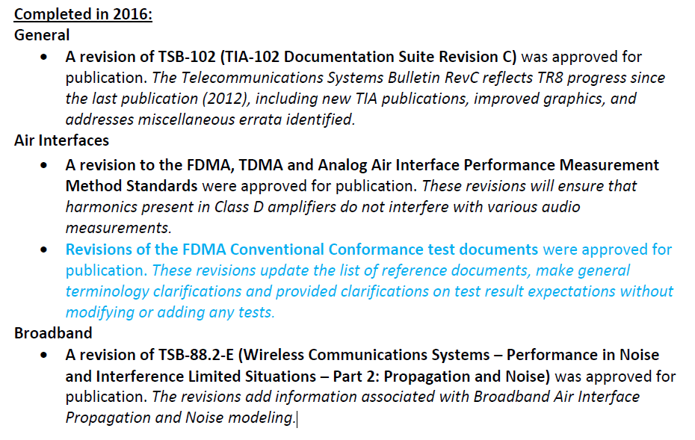
Frequencies, Bandwidth and Standards
Standards are established and reviewed by the TIA’s TR-8 Subcommittee several times/year.

Slide 20
Delivered Audio Quality (DAQ)
Mean opinion scores from tests have created the following descriptors of speech recognition:
DAQ Description
1 | Unusable. Speech present but not understandable.
2 | Speech understandable with considerable effort. Requires frequent repetition due to noise or distortion.
3 | Speech understandable with slight effort. Requires occasional repetition due to noise or distortion.
3.4 | Speech understandable without repetition. Some noise or distortion present.
4 | Speech easily understandable. Little noise or distortion.
4.5 | Speed easily understandable. Rare noise or distortion.
5 | Perfect. No distortion or noise discernible.

Slide 21
Bit Error Rate
A Bit Error Rate (BER) of 5% equates to a received signal strength roughly equal to the same signal strength one would see for 12 dB SINAD
A BER of between 2.4 – 2.5 % is what’s been shown to produce a DAQ of 3.4 (speech understandable without repetition)
Depends on the results of Mean Opinion Scores – HIGHLY SUBJECTIVE!
For this reason, Project 25 voice quality is perceived to be a significant drawback for some users.

Slide 22
Pros and Cons of Project 25
Pros
Cons
Proven in Public Safety use for over 15 years
Scalable to suit the size of your agency
Interoperability with other Project 25 equipment vendors assured through the CAP (Compliance Assessment Program)
Multiple vendors from which to choose
Backward compatible and ‘future proof’
Voice Quality a concern for some
Low immunity to interference and multipath effects compared to analog systems
Data transmission limit of 9.6 kbps (for narrow-band systems)
Sharp drop off in voice quality under low signal conditions make Project 25 inappropriate for ‘Fireground’
Latency
No support for paging

Slide 23
Questions?
steven.sciotto@radionetcom.com

